Slide 1
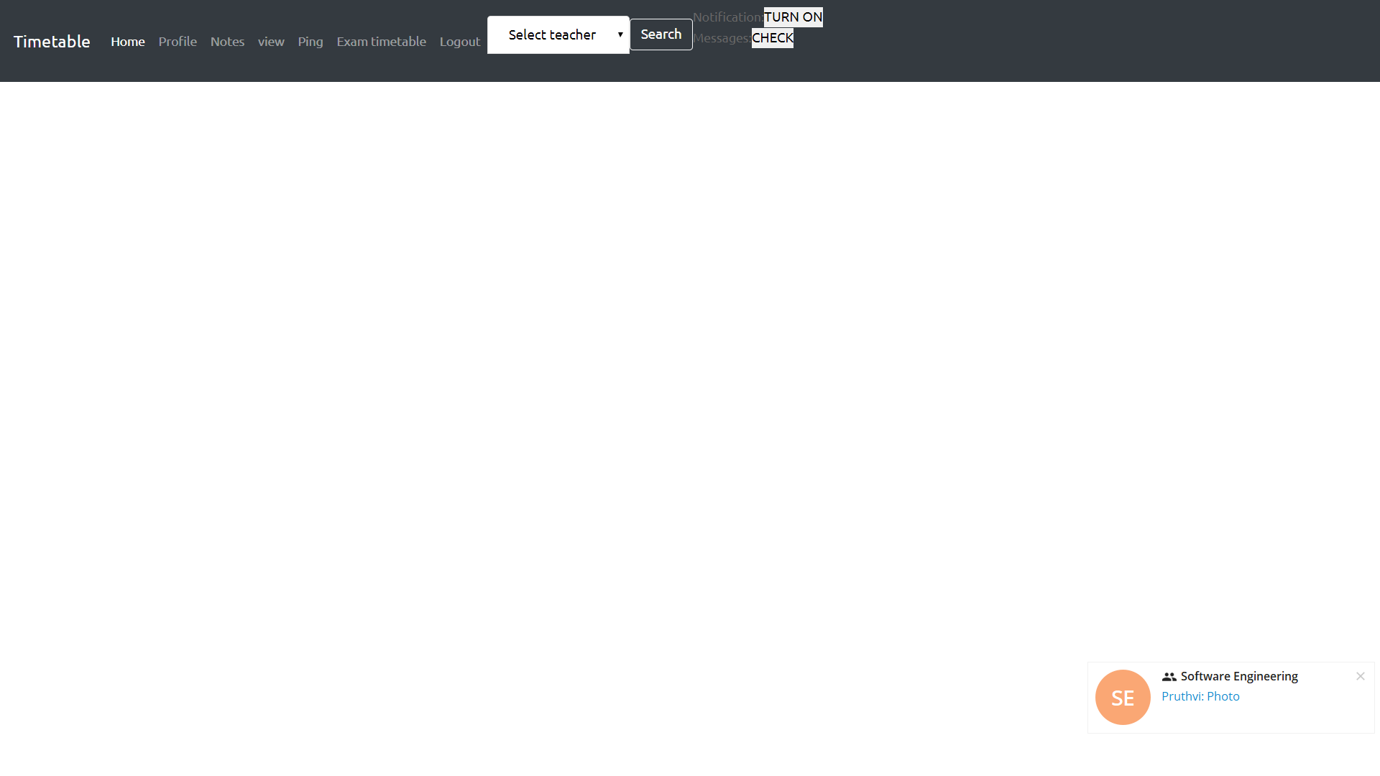
Takes you to the main page of the dashboard

Slide 2
Shows the profile of the logged in teacher.

Slide 3
This shows the notes, the logged in user has written.

Slide 4
This shows the timetable of the logged in teacher.

Slide 5
Allows to contact other teachers

Slide 6
This shows the up coming exam timetable.

Slide 7
This logs you out of this particular session.

Slide 8
You can view the profile and timetable of other registered teachers.

Slide 9

This enables/disables notifications, on upcoming classes.

Slide 10
Check the pings from other teachers

